Slide 1
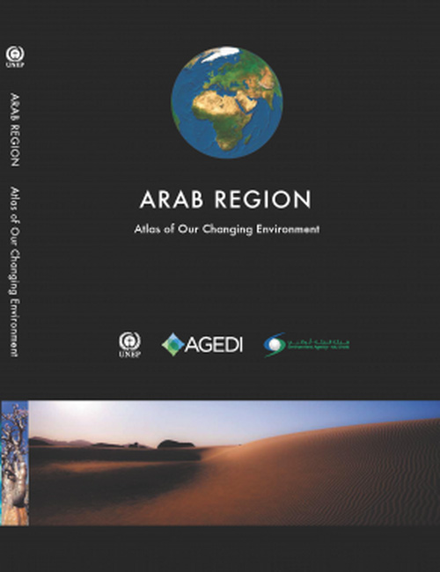
OFFICIAL LAUNCH OF THE ARAB REGION ATLAS OF OUR CHANGING ENVIRONMENT

Slide 2
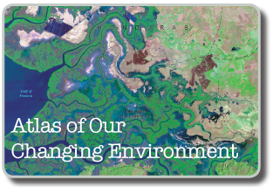
ATLAS of our changing environment Series
The Atlas of Our Changing Environment publications use a combination of ground photographs, current and historical satellite images and narrative based on extensive scientific evidence to illustrate how humans have altered their surroundings and continue to make changes to the environment
Demonstrates the importance of developing, harnessing and sharing technologies that help provide deeper understanding of the dynamics of environmental change
Words and pictures serve as a vivid reminder that this planet is our only current home, and that sound policy decisions and positive actions by societies and individuals are needed to sustain the Earth and the well-being of its inhabitants

Slide 3
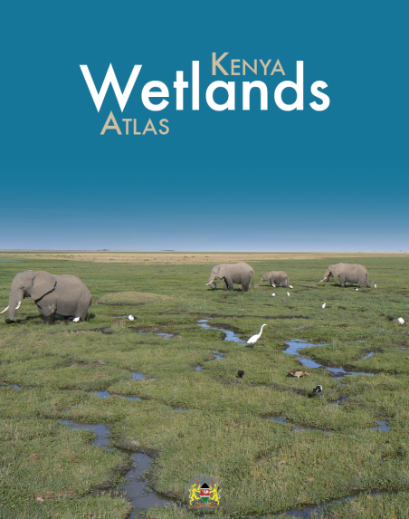
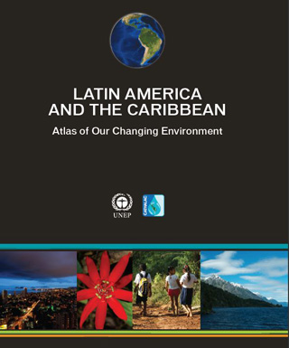
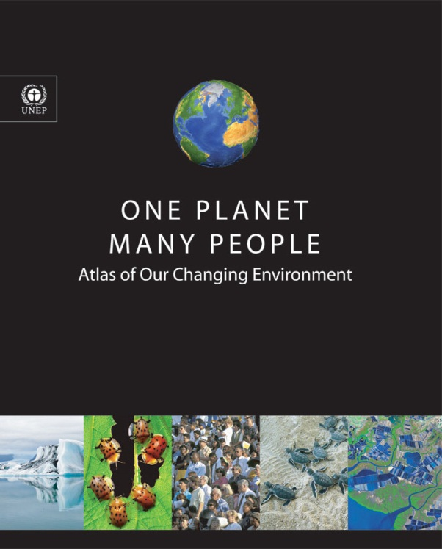
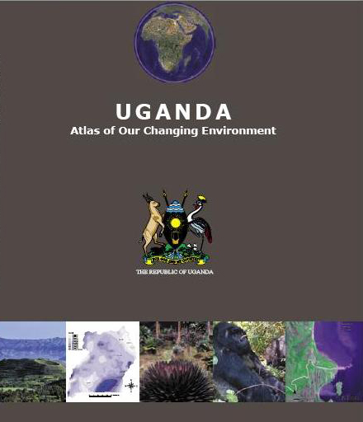
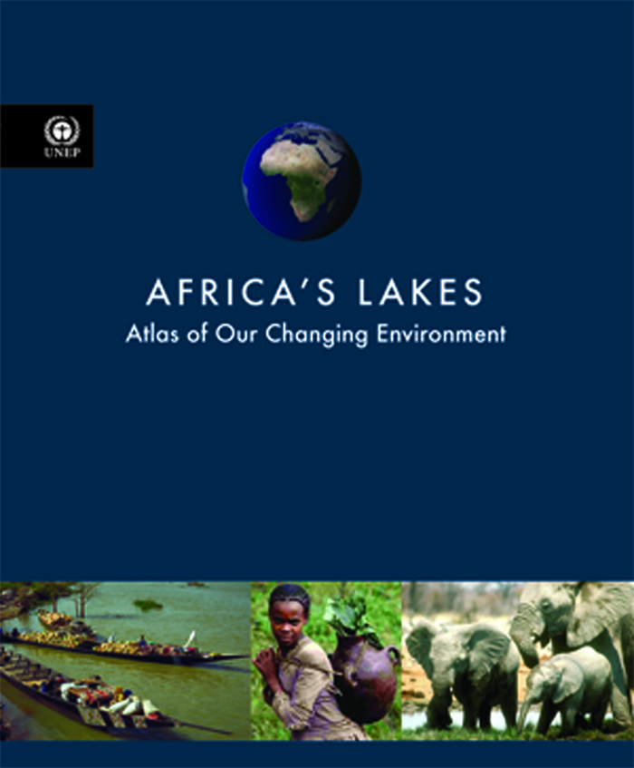
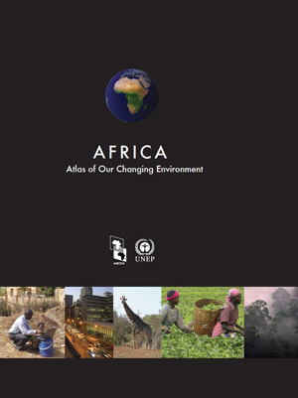
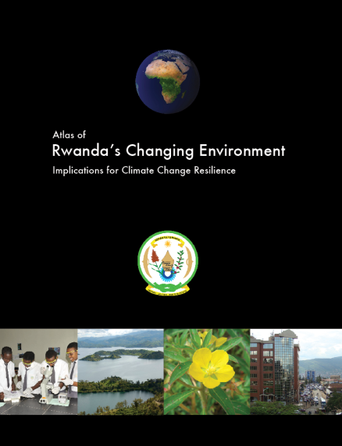
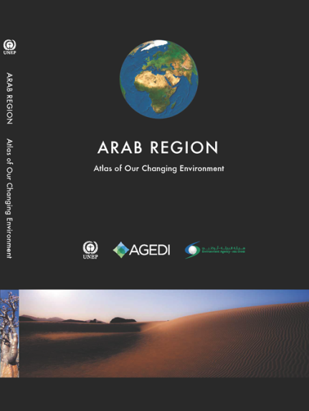

Slide 4
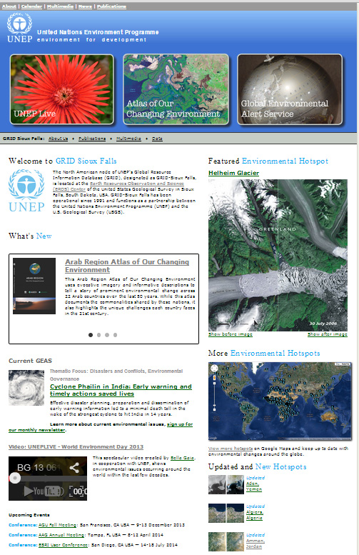
http://na.unep.net

Slide 5
COMING SOON:
YouTube video
E-book

Slide 6
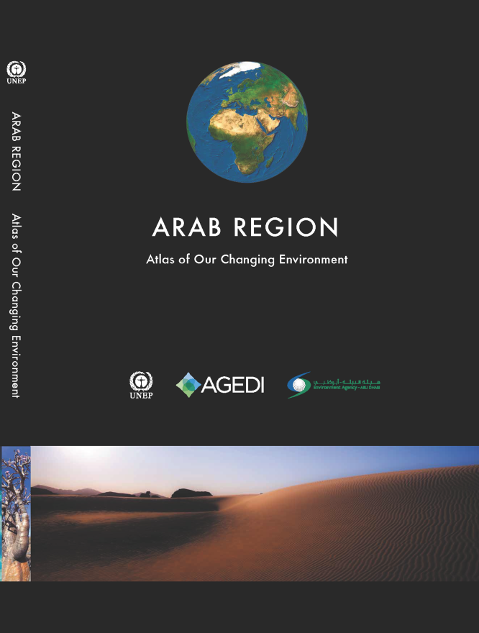
Arab Region Atlas of Our Changing Environment
67 hotspots in 22 countries, illustrated through ~140 satellite images
Some of the changes illustrated:
Rapid urbanization
Coastal development
Expansion of agriculture
Impacts of volcanic eruptions
Deforestation

Slide 7
What is a hotspot?
A significant area of Earth’s surface that is susceptible to slow-onset or rapid environmental change, positive or negitive
Can be explained using satellite and aerial imagery, ground photos and descriptive text
Identified by scanning imagery, reviewing literature, local knowledge, expert consultation and current events

Slide 8
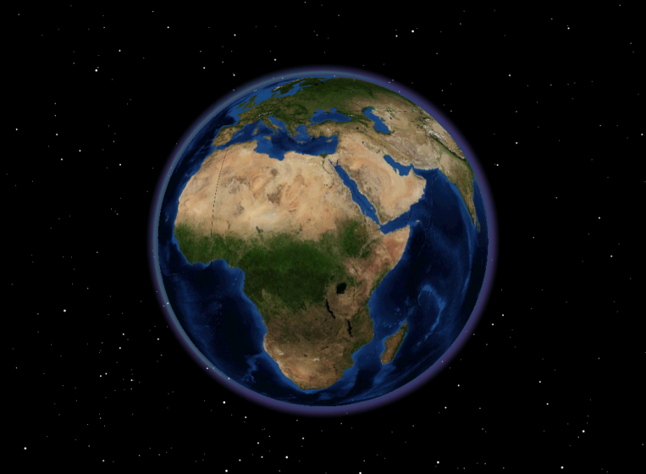
UNEP Environmental Change Hotspots
More than 270 hotspots identified
Spanning all 7 continents
In more than 100 countries
Four themes:
Climate Change and Atmosphere
Disasters and Conflicts
Ecosystems
Resource Extraction
Information is accessible in a variety of ways

Slide 9
Access through Google Maps interface
http://na.unep.net/google.php
Hosts the 270+ hotspots for global access
Hotspots identified from atlases, reports and GEAS bulletins
Contains satellite & aerial imagery, ground photos and descriptive text
Dynamically updated through the use of an administrative tool developed by UNEP/GRID-Sioux Falls

Slide 10
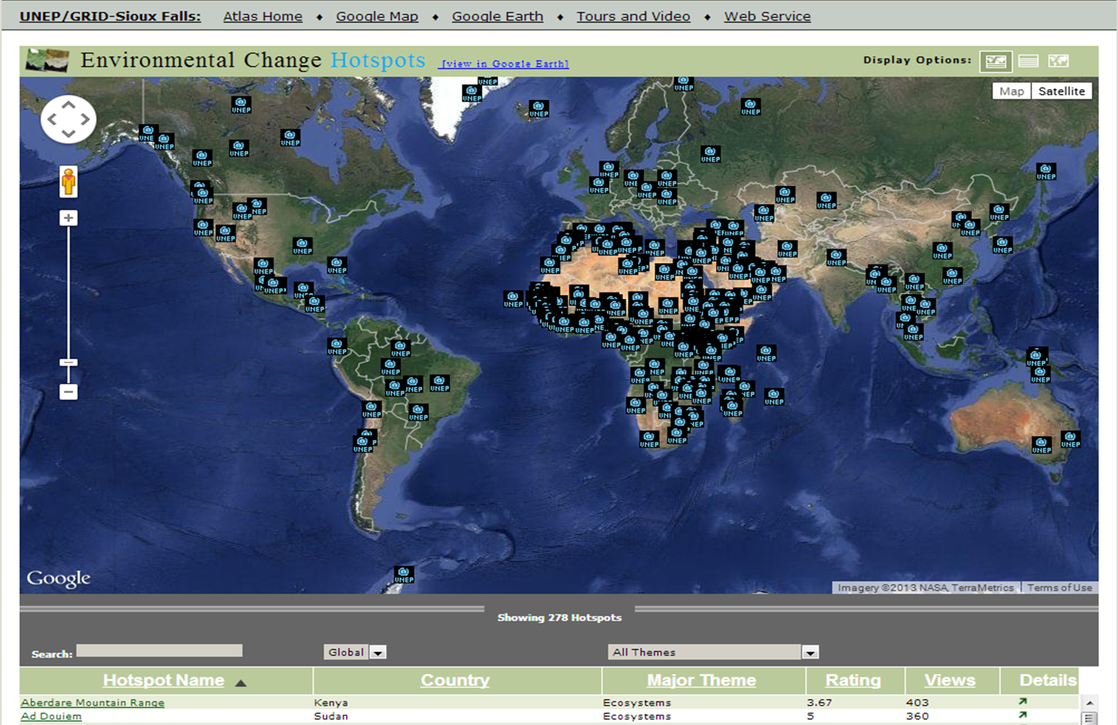

Slide 12
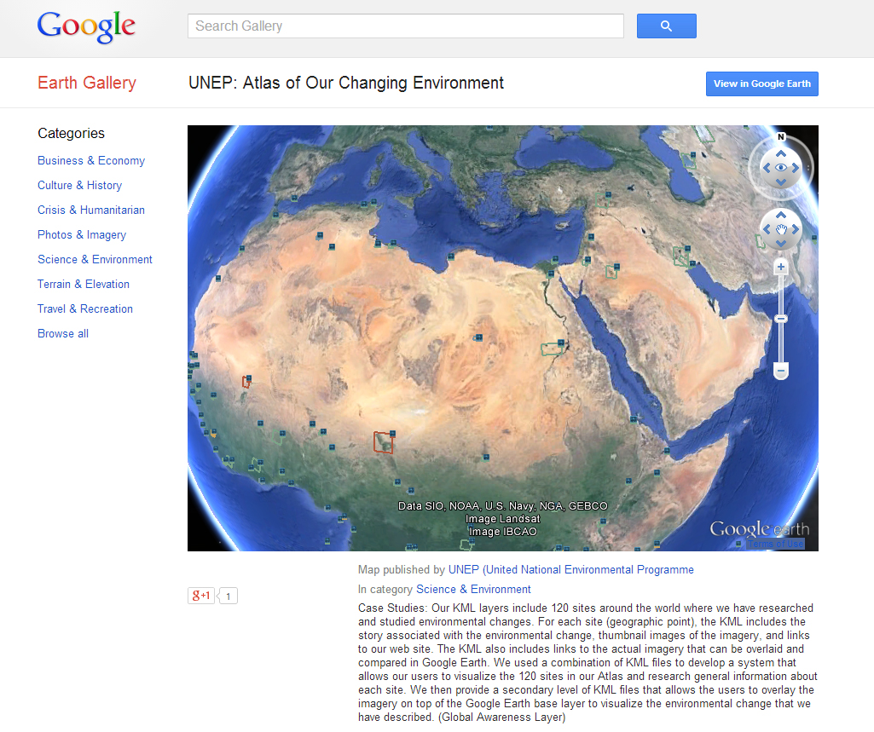
Access through Google Earth Layer
Featuring more than 200 hotspots from the Atlas of Our Changing Environment Series
Downloadable KML to view in the Google Earth and Google Earth Pro software programs
View in Google Earth under “Global Awareness layer”

Slide 13
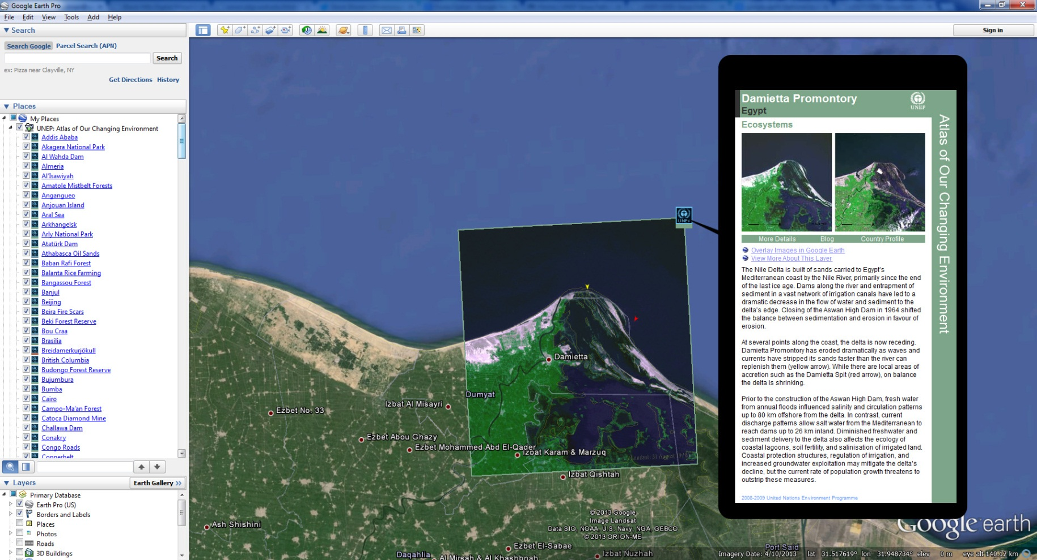
Google Earth layer

Slide 14
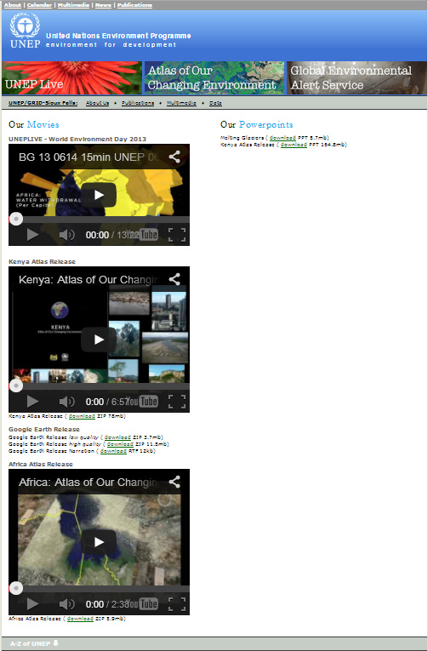
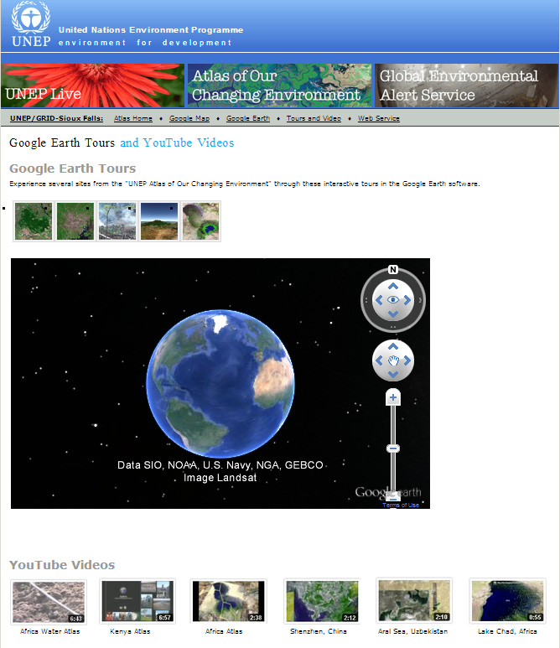
Access through multimedia

